Slide 1
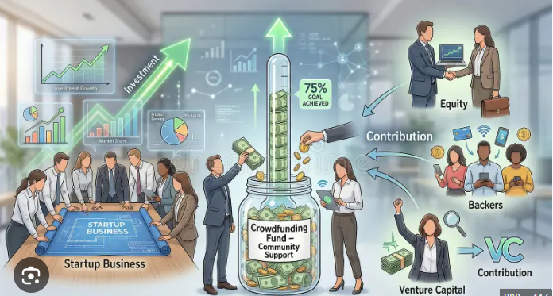
CROWD FUNDING PROJECT
EXCELR
P1187-6th Group

Slide 2

Team Members
Tanuja Ghandge
Lekhya Sree
Shravani Pravin Bhosale
Velugula Jasmitha
Harshavardhana
Aaysha Khan
Sudharshan

Slide 3
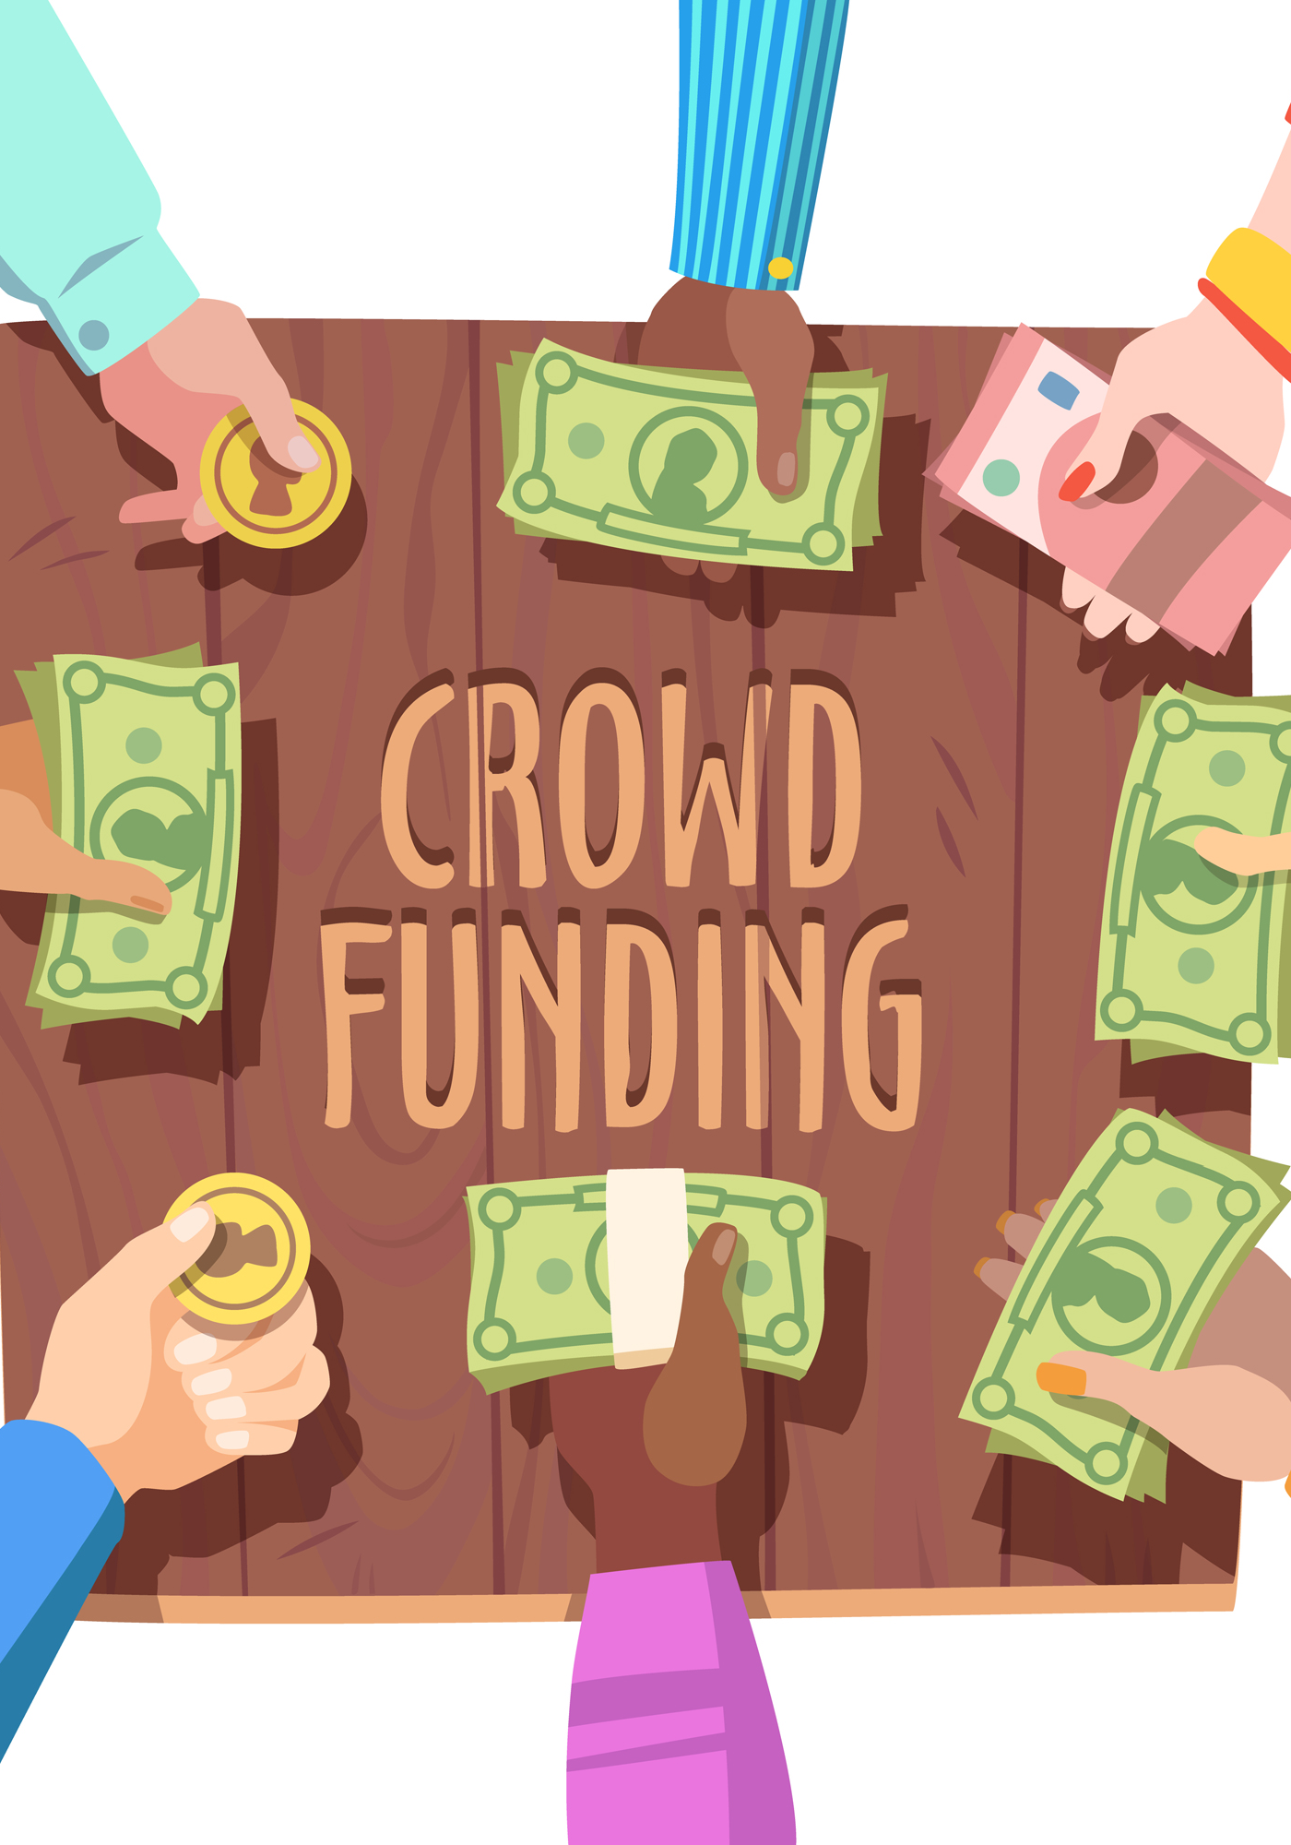
Project Introduction
This project focuses on analyzing crowdfunding campaign data using multiple analytical tools to generate meaningful insights. The analysis helps understand campaign performance, funding goals and factors influencing successful crowdfunding campaigns.
Project Scope
An end-to-end data analysis project combining Excel, MySQL, Tableau, and Power BI to clean, manage, and visualize large crowdfunding datasets.
Core Focus Areas
• Campaign performance analysis • Funding trend identification • Multi-tool data analysis approach • Interactive dashboard development

Slide 4

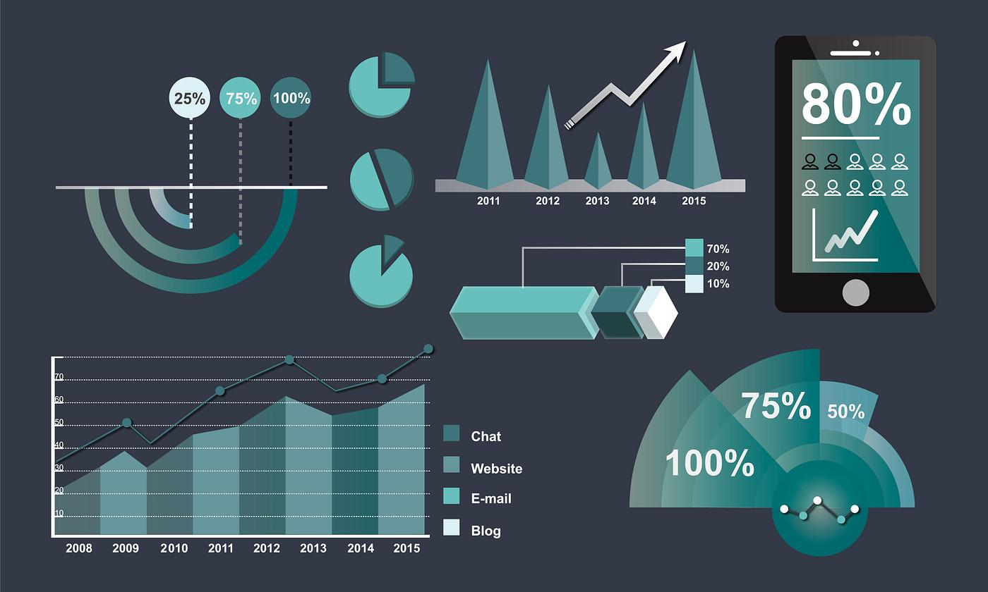
Overview
Project Overview
This project analyzes a crowdfunding campaign dataset to understand campaign performance and funding trends. The analysis involves data cleaning, database management, and visualization using tools such as Excel, MySQL, Tableau, and Power BI. The goal is to generate insights that help understand patterns in crowdfunding campaigns.
Key Objectives
Analyze crowdfunding campaign performance
Identify funding trends and patterns
Process and manage large datasets
Present insights through dashboards

Slide 5


Tools Used

Slide 6


Slide 7
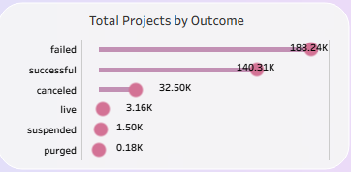
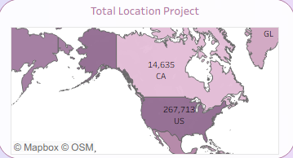
Project Overview KPIs
Analysis
Most projects ended in failure (188K) while successful projects are 140K. Only a small number of projects were canceled, live, or suspended.
Analysis
Most projects come from the United States (267K). Canada has around 14K projects, showing much lower participation compared to the US.

Slide 8
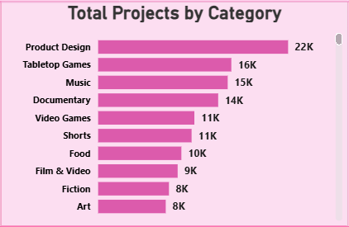
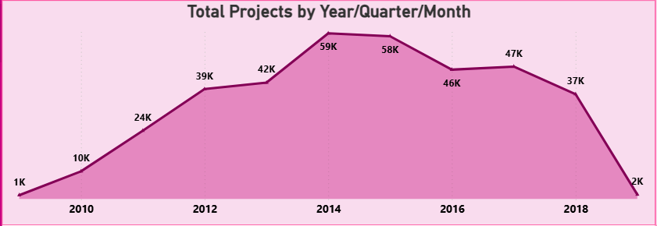
Analysis
Product Design has the highest number of projects (22K). Tabletop Games and Music are also popular, while Film, Fiction, and Art have fewer projects.
Analysis
Projects increased from 2010 to 2014, reaching the peak. After 2015 the number of projects gradually decreased.

Slide 9

Successful Projects KPIs
Analysis
Total Amount Raised
The total amount raised by all projects is 4278M, showing strong overall funding support.
Backers
The projects received around 40 million backers, indicating high public participation.
Average Days
The average project duration is about 31.87 days, meaning most campaigns run for nearly one month.

Slide 10
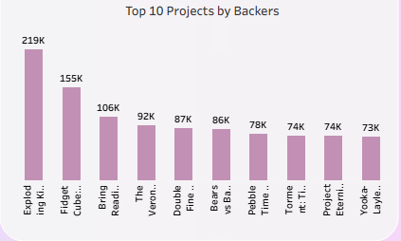
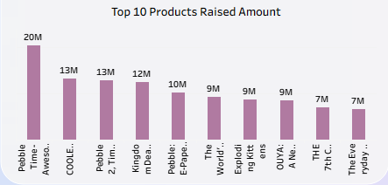
Top Successful Projects
Analysis
Some projects received very high backer support (up to 219K) and raised millions of dollars, showing strong public interest.
Analysis
The highest funded product raised around 20 million, while other top projects raised between 7M and 13M, showing strong investor support.

Slide 11

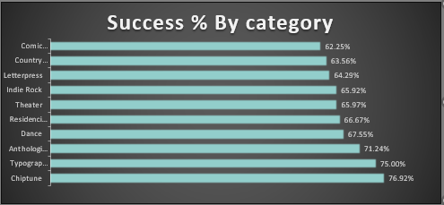
Percentage of Successful Projects
Analysis
The overall success rate is 39.18%, meaning less than half of the projects become successful.
Analysis
Some categories have higher success rates (around 70–76%), while others have lower success percentages, showing that success depends on the project type.

Slide 12
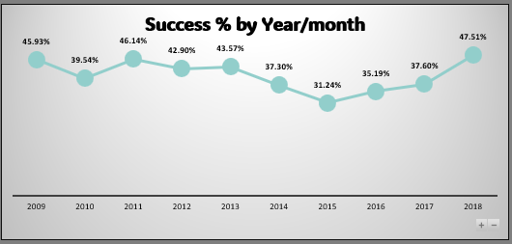
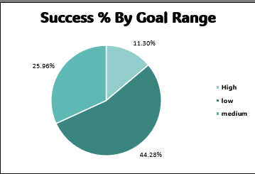
Analysis
The success rate fluctuates over the years, dropping around 2015 and increasing again by 2018
Analysis
Projects with medium funding goals have the highest success rate, while high funding goals have the lowest success rate.

Slide 13
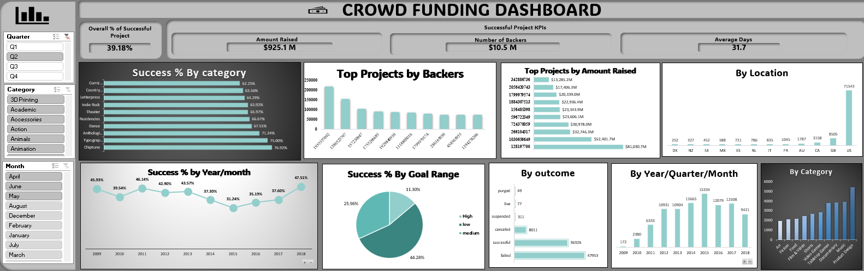
Excel Dashboard

Slide 14
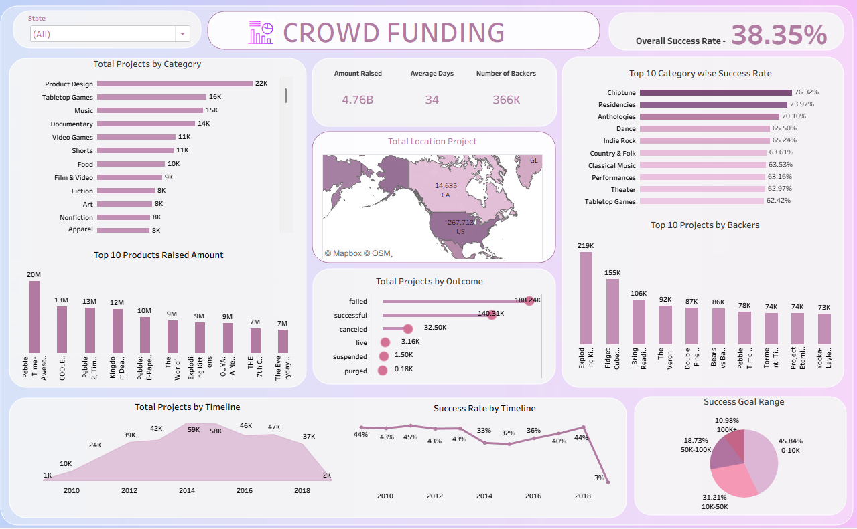
Tableau Dashboard

Slide 15
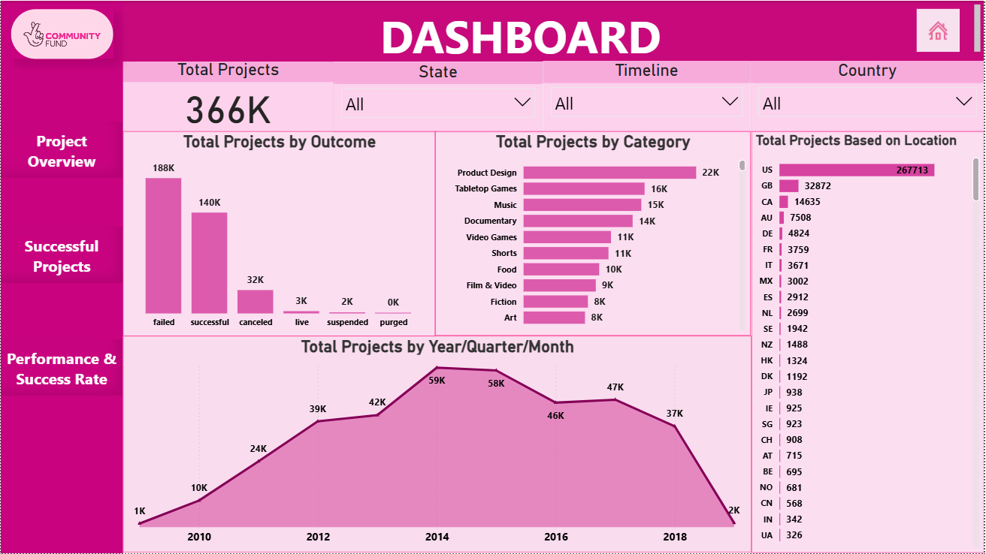
PowerBI Dashboard

Slide 16
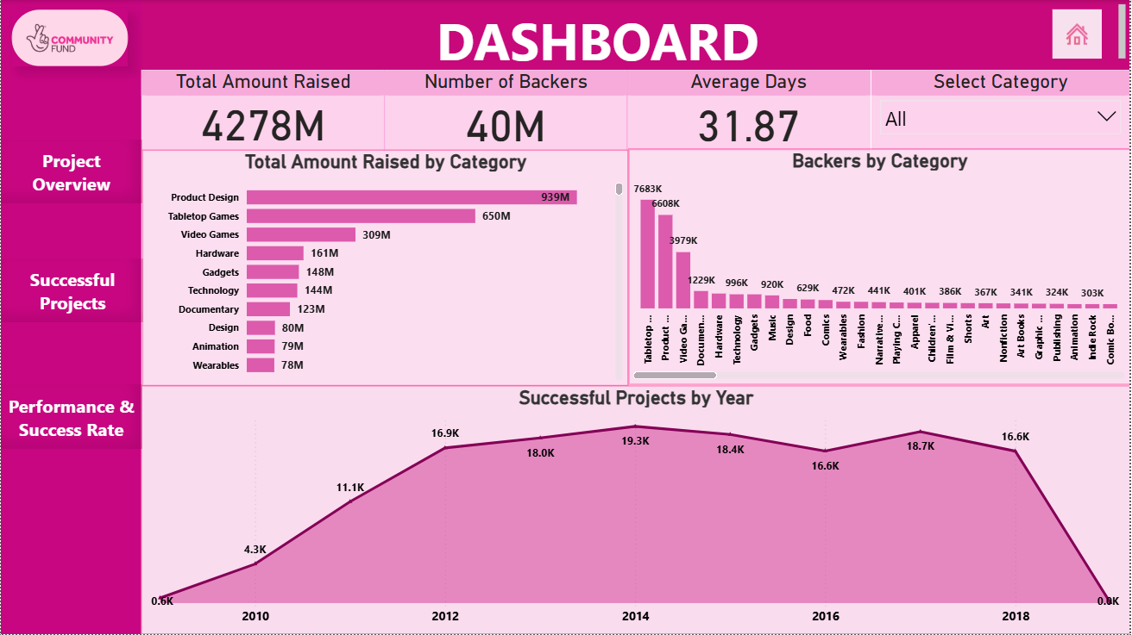

Slide 17
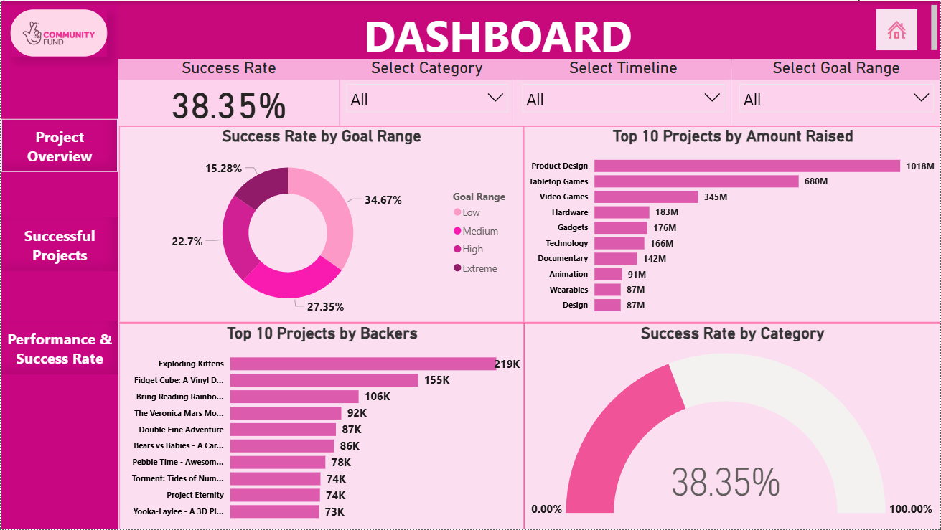

Slide 18
Conclusion
Crowdfunding helps creators raise funds from a large number of people through online platforms.
The analysis shows that many projects are launched, but only about 39% become successful.
Categories like Product Design, Games, and Music attract more projects and support.
The United States has the highest number of projects and backers.
Projects with realistic funding goals and strong public interest are more likely to succeed.

Slide 19
Suggestions
Focus on Popular Categories: Projects in Technology, Games, and Design attract more backers; consider these trends when planning campaigns.
Optimize Campaign Duration: Moderate campaign durations lead to higher success; avoid too short or excessively long campaigns.
Target Active Regions: Regions like USA and UK show higher crowdfunding participation; marketing and outreach can focus here.
Engage Backers Effectively: Clear project descriptions, visuals, and regular updates increase campaign success rates.
Leverage Data Insights: Use analytics to monitor trends, funding patterns, and campaign performance for continuous improvement.

Slide 20
Thank you

